Slide 1
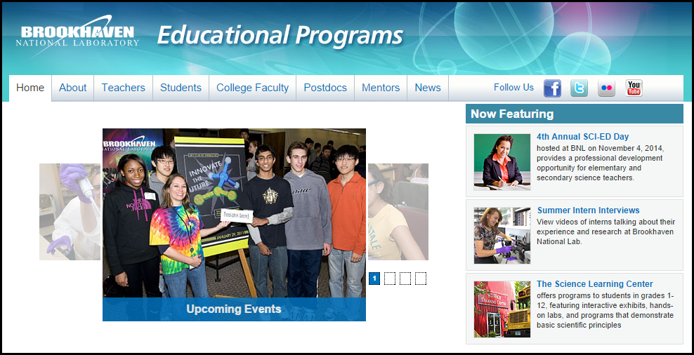
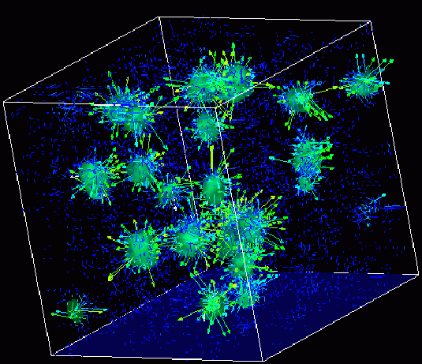

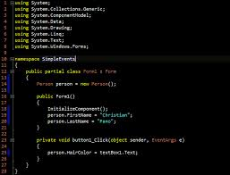
Advanced
Scientific Computing
(SciComp 201)
Session 02
Analytic Number Theory

Slide 2
Session Goals
Understand the history and design intent of C++
Discuss the strengths & weaknesses of C++
Review the build (compile & link) process and output files
Access your Amazon Cloud hosted remote workstation
Explore the file system structure of a VS2015 C++ Solution
Map relationship between header files and source files
Review the intrinsic (native/built-in) data types in C++
Consider the impact of x86 (32-bit) vs x64 (64-bit) builds

Slide 3
Session Goals
Generate & sum pseudo-infinite series in code
Map sigma elements to code constructs such as for() loops and accumulating variables
Compare convergent vs. divergent series
Understand the Basel Problem and Euler’s amazing result
Learn how Euclid’s Greatest Common Divisor (GCD) algorithm provides the correct result without factoring
Determine the probability that two random positive integers are coprime (share no common factors other than 1)

Slide 4
History & Design Intent of C++
Built on “C” – language of original UNIX operating system
Windows, Linux, iOS, MacOS, Android = All written in C++
98% of best selling video games = All written in C++
You should know the language of your operating system!
C++ is both high-level and low-level
Provides “direct access” to OS & GPU controlled memory
Can embed Intel assembly language for direct register access
No JVM or CLR intermediary - no background garbage collector
Very small executables – the OS already contains the C++ libraries
Very power efficient on mobile devices

Slide 5
History & Design Intent of C++
Goverened by an ISO committee: https://isocpp.org
Recent versions are C++98, C++03, C++11, C++14, C++17
Advancement slowed greatly between 2003 and 2011
Java and C# fixed a lot of C++ hassles, but C++ continues to “catch up” to implement similar features
Things you will miss from Java / C#
C++ uses one-pass compilation - all resources & functions must be declared before referenced
Heavy use of “header” files and explicitly linked static libraries – there is no reflection API (coming in C++17)
Memory exceptions & leaks are much more frequent!

Slide 6
History & Design Intent of C++
At times C++ has very wonky syntax, which requires significant attention to detail on your part
There is a huge difference between int* x; and int& x;
C++ is about programmer power, while Java/C# is about programmer productivity
BNL scientists develop C++ on Linux, not MS Windows
We will show how to make your .h and .cpp code portable between Visual Studio 2015 on Windows and Code::Blocks on Linux (which uses the gcc compiler)
The goal is to write source code that does not need to be modified to be compiled on both operating system platforms

Slide 7
Useful Reference Sites
http://en.cppreference.com/w
http://www.cplusplus.com/doc/tutorial
http://c-faq.com
http://www.cprogramming.com
What you should know about C++11
The standard way of converting between numbers and strings in C++11

Slide 8
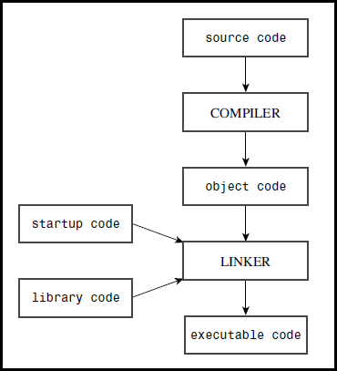
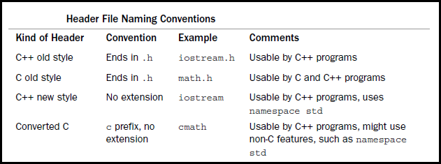
C++ Build Process
A header between <> brackets (preferred) adds symbols to the compiler’s std namespace, not the user’s global namespace like “header.h” will

Slide 9
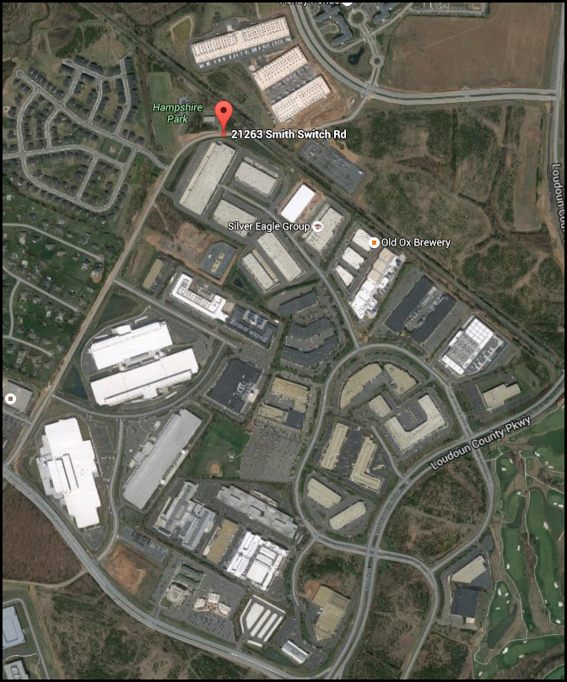
Amazon’s
23 data centers in Ashburn, Virginia

Slide 10
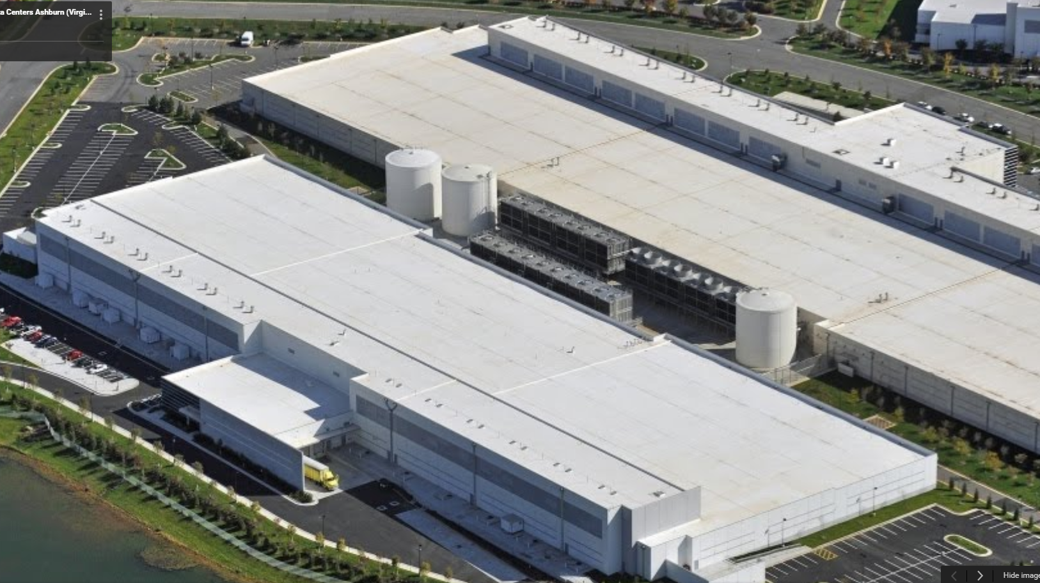
Just two of Amazon’s 23 cloud
data centers in Ashburn, Virginia

Slide 11
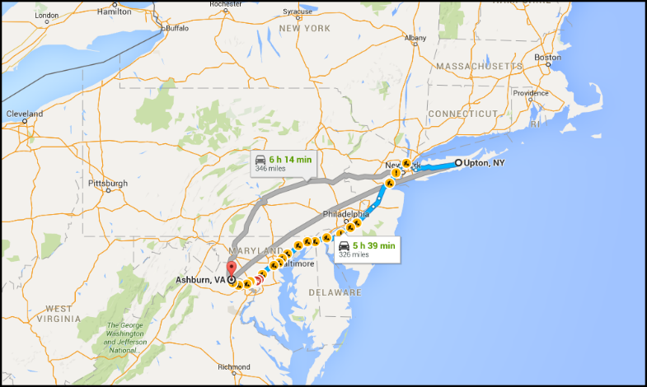
BNL ↔ Ashburn
Roundtrip = 660 miles

Slide 12
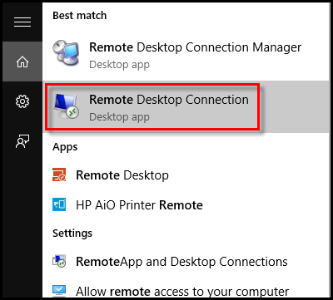
Accessing your Remote PC
Launch Microsoft’s “Remote Desktop Connection” application
Make sure you write down
The IP address of your specific machine in Amazon’s cloud
The user name (case insensitive)
The password (case sensitive)
You can access your Amazon machine from your home computer too!
I will remotely monitor your progress on the lab exercises

Slide 13
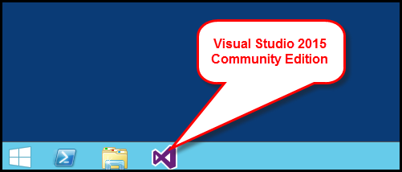
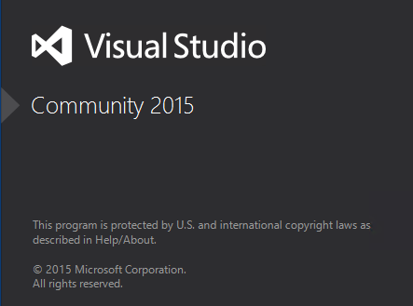
Launching Visual Studio

Slide 14
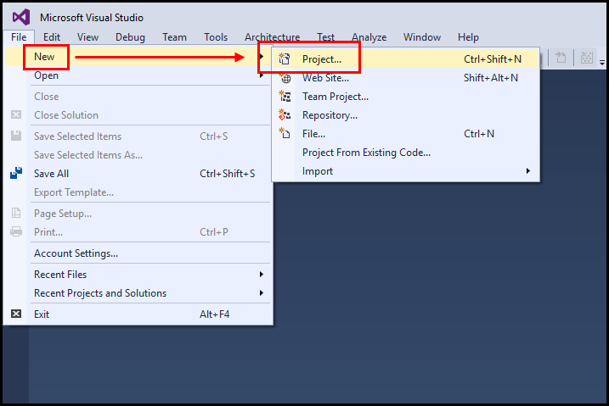
Visual Studio 2015 – New C++ Project

Slide 15
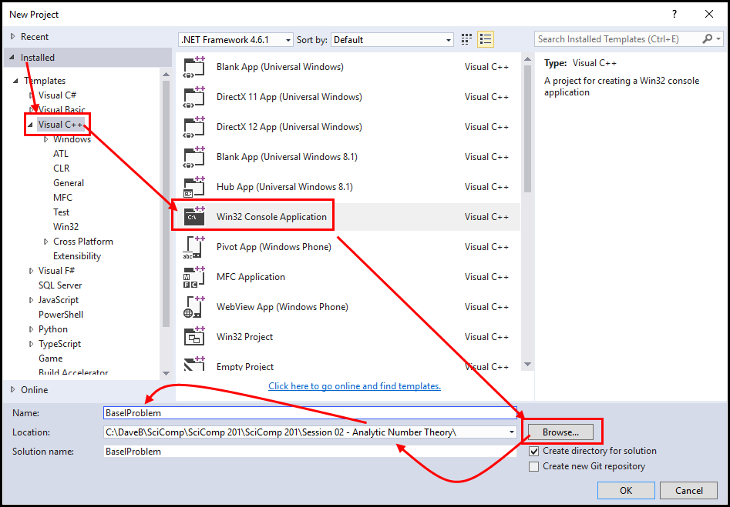
Visual Studio 2015 – New C++ Project

Slide 16
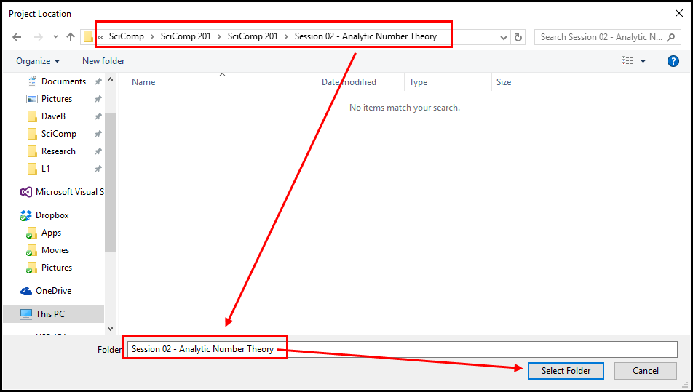
Visual Studio 2015 – New C++ Project

Slide 17
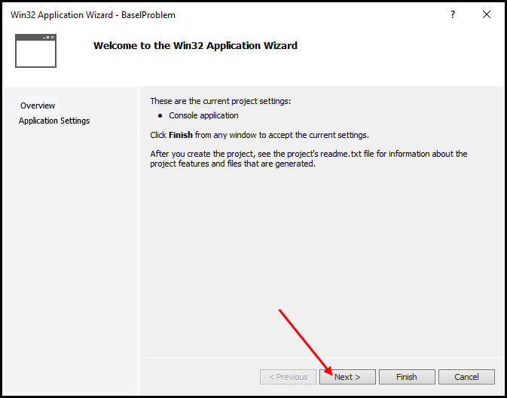
Visual Studio 2015 – New C++ Project

Slide 18
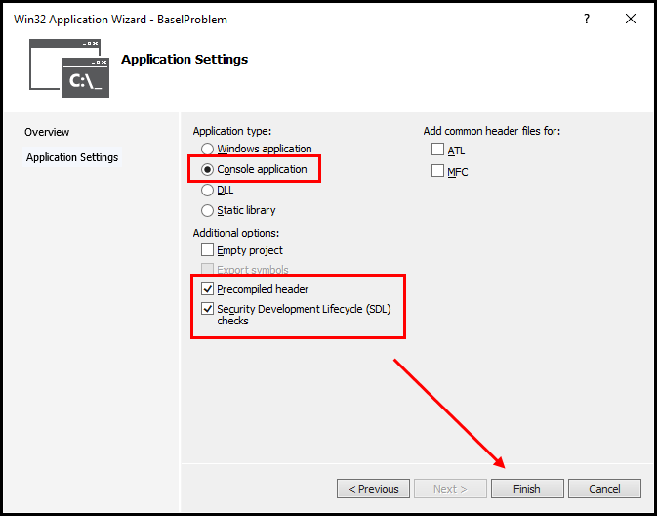
Visual Studio 2015 – New C++ Project

Slide 19
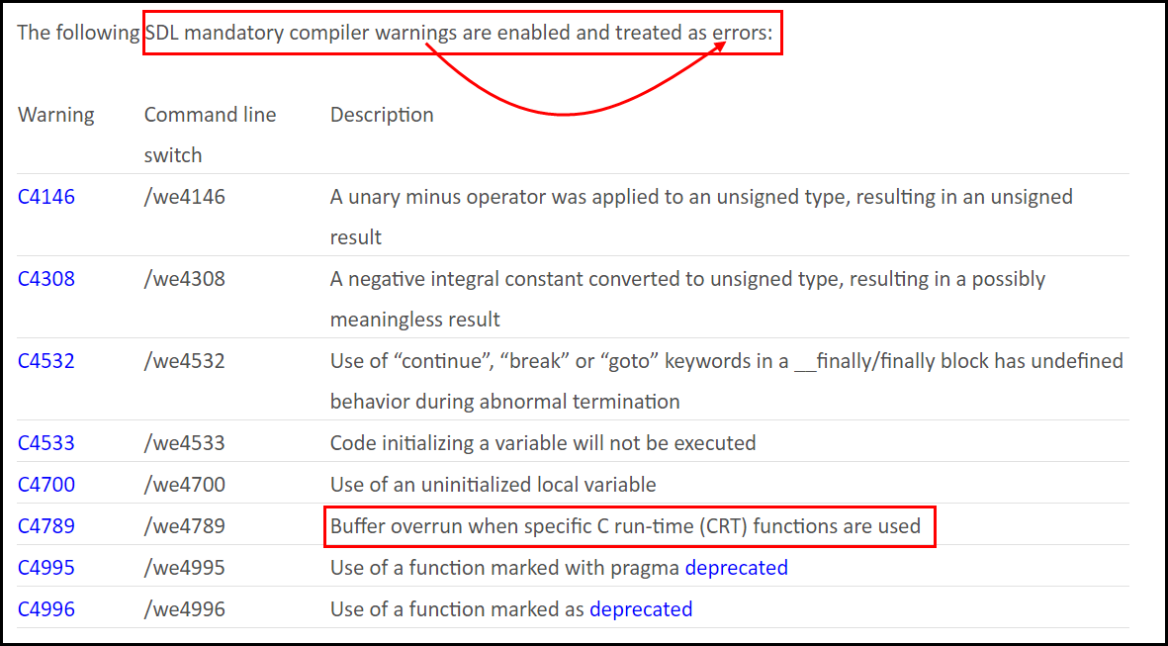
Security Development Lifecycle (SDL) Checks

Slide 20
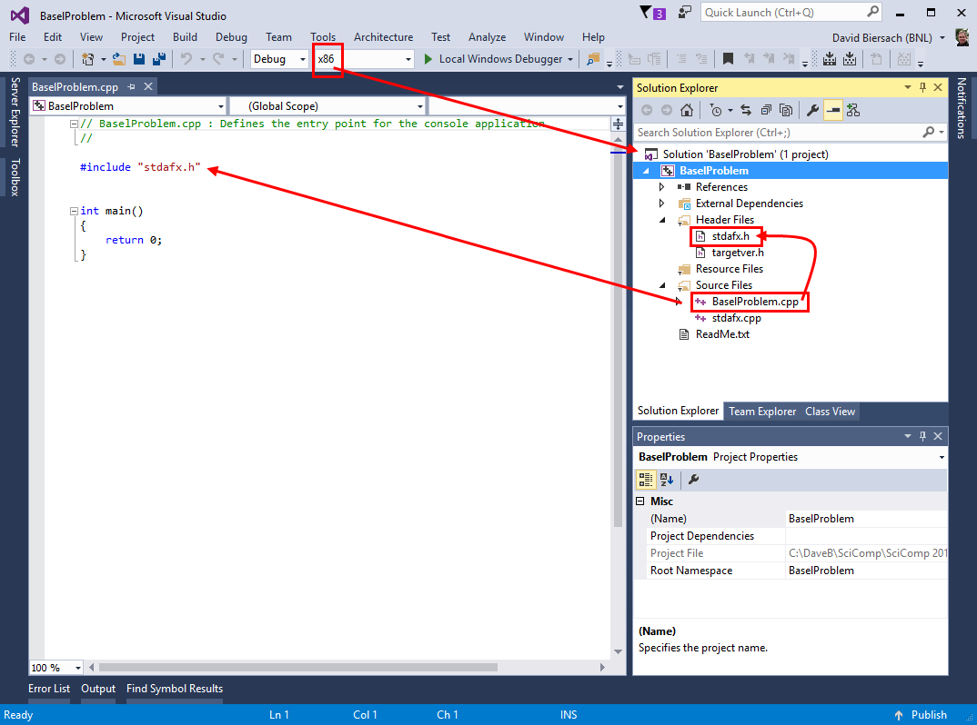
Visual Studio 2015 – New C++ Project
x86 = 32-bit Builds (LP32 mode)
x64 = 64-bit Builds (LLP64 mode)

Slide 21
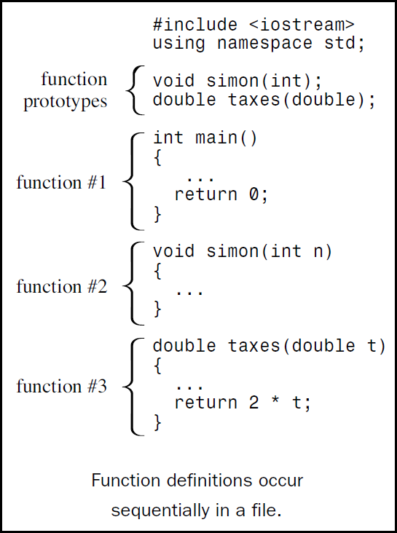
.cpp File Layout – Declare before Reference

Slide 22
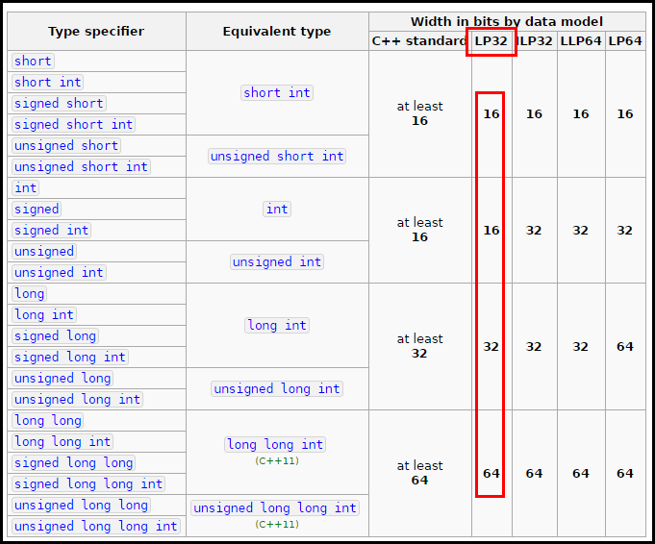
C++ Intrinsic Data Types
http://en.cppreference.com/w/cpp/language/types
x86 = 32-bit Builds (LP32 mode)
x64 = 64-bit Builds (LLP64 mode)

Slide 23
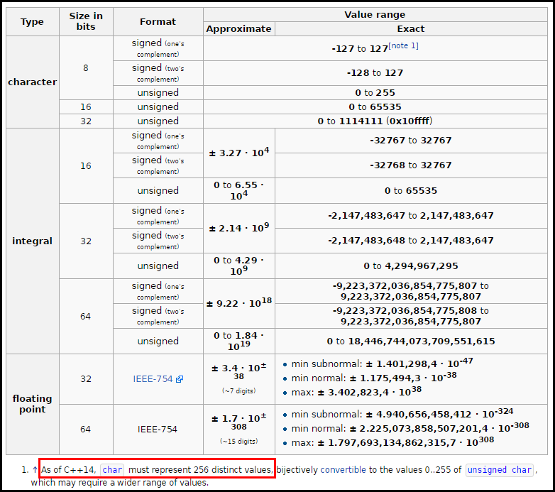
C++ Intrinsic Data Types
http://en.cppreference.com/w/cpp/language/types

Slide 24
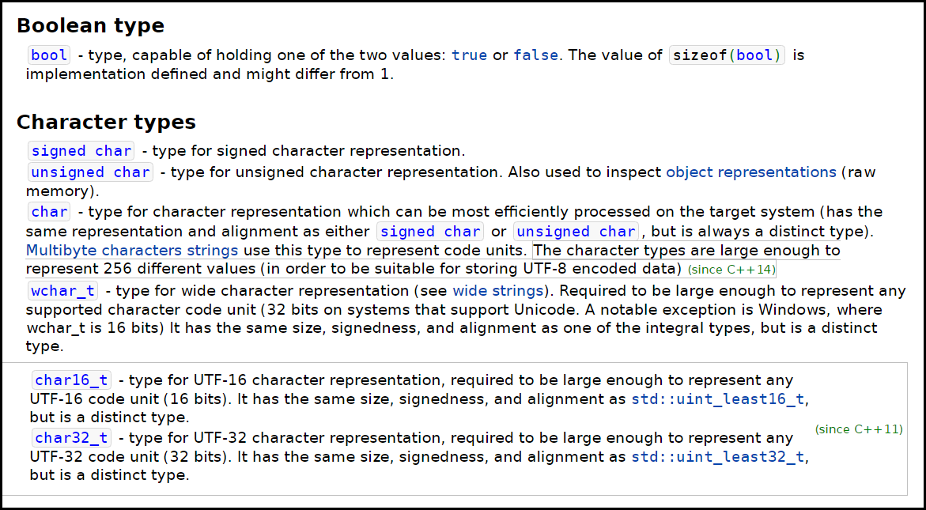
C++ Intrinsic Data Types
http://en.cppreference.com/w/cpp/language/types

Slide 25
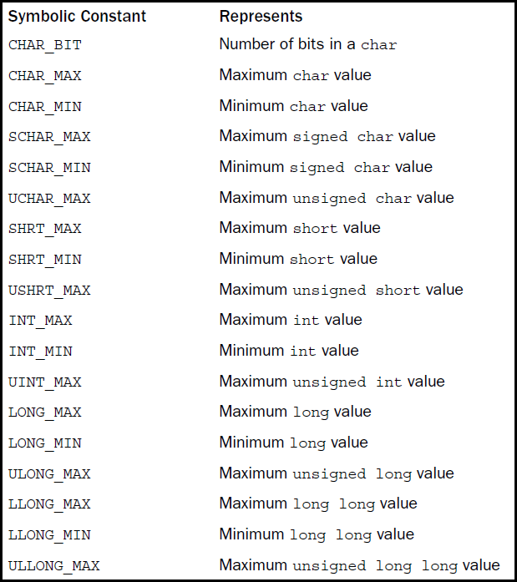
<climits>
http://www.cplusplus.com/reference/climits

Slide 26
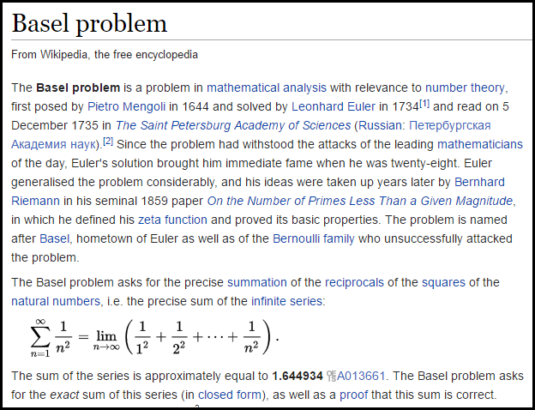

Slide 27
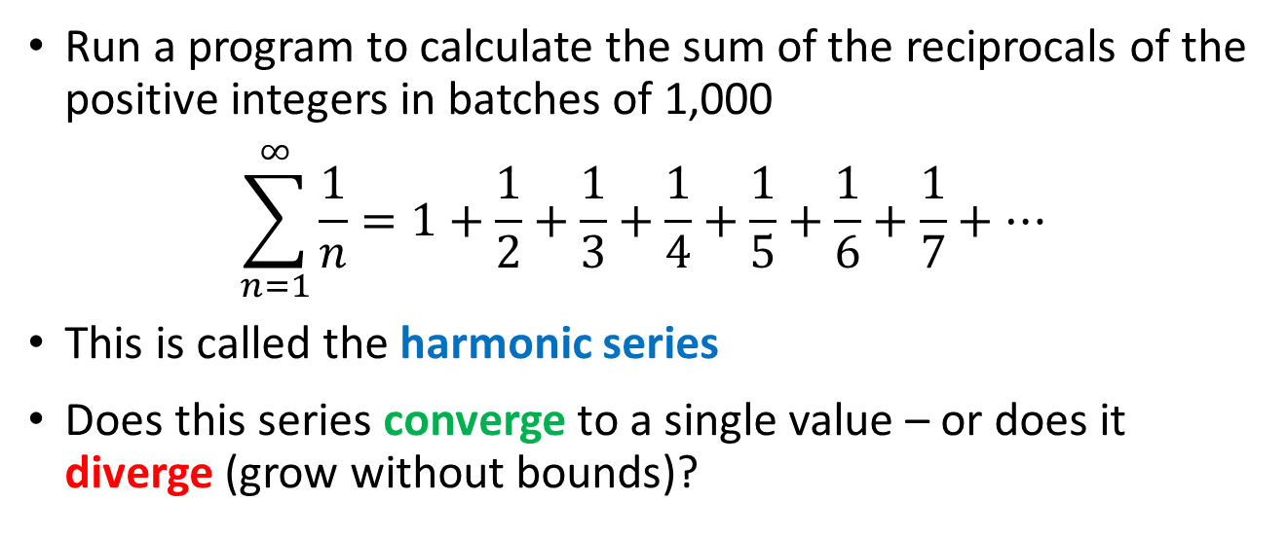
Lab 1 – Basel Problem
Run a program to calculate the sum of the reciprocals of the positive integers in batches of 1,000
$$\sum_{n=1}^{∞}{\frac{1}{n}=1+\frac{1}{2}+\frac{1}{3}+\frac{1}{4}+\frac{1}{5}+\frac{1}{6}+\frac{1}{7}+…}$$
This is called the harmonic series
Does this series converge to a single value – or does it diverge (grow without bounds)?

Slide 28
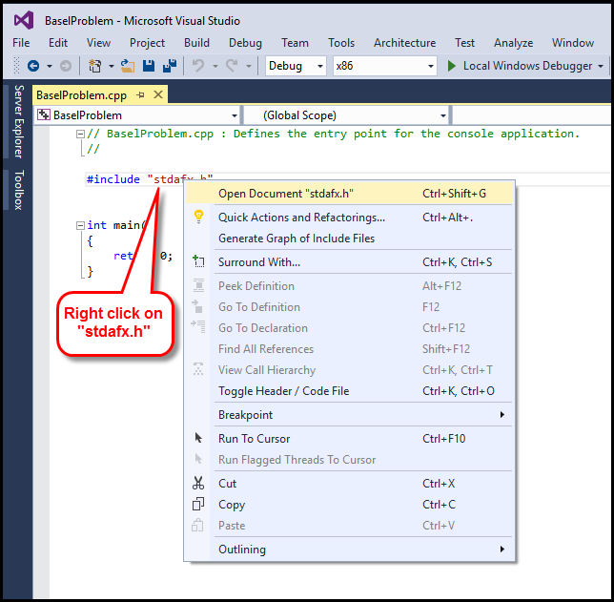
Adding Header Files to stdafx.h

Slide 29
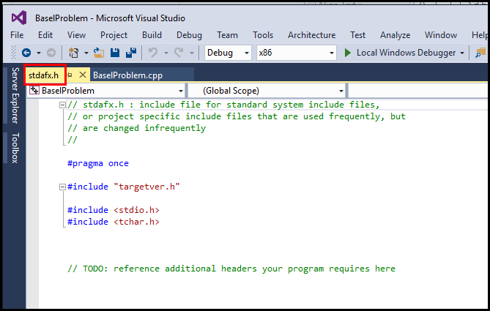
Adding Header Files to stdafx.h

Slide 30
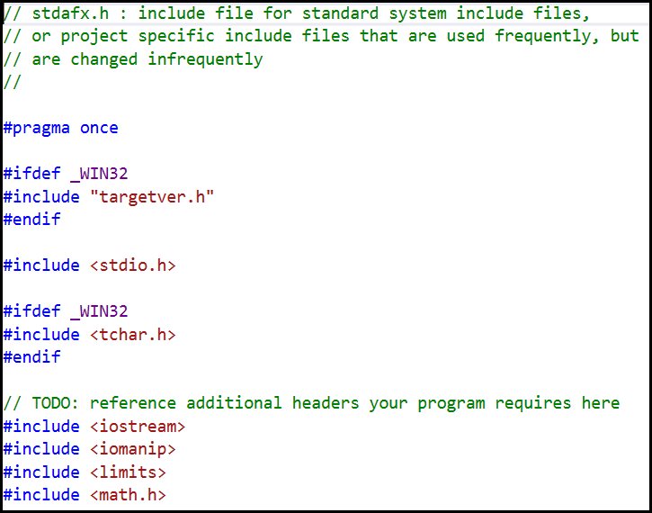
Adding Header Files to stdafx.h
Preprocessor directives
Skips MS proprietary headers when on Linux

Slide 31
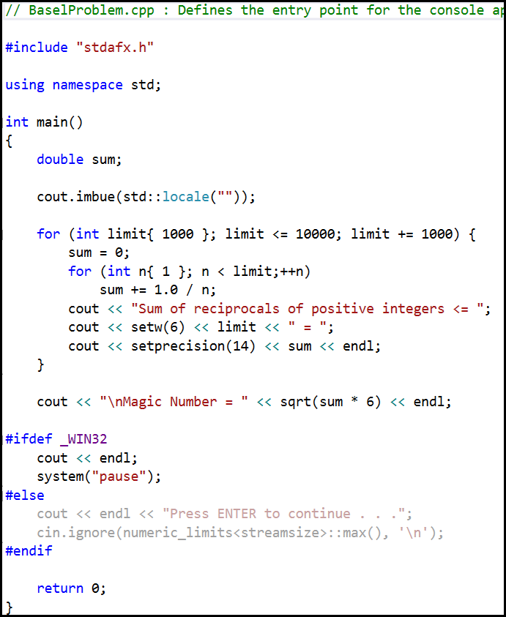
main()
Namespaces
std
cout.imbue()
Using {} to init
Braces in vs. out
Prefix ++ op
Explicit 1.0 cast
cout << op
setw()
setprecision()
endl
\n newline escape
sqrt()
_WIN32
system(“pause”)
cin.ignore()
numeric_limits

Slide 32
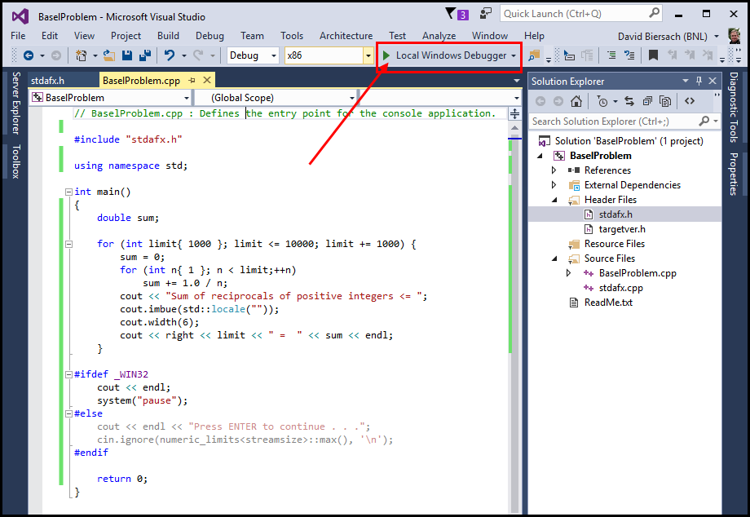
Running the Application (F5)

Slide 33
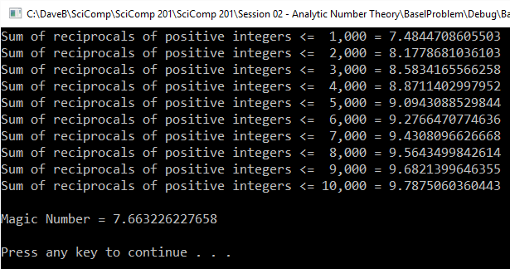
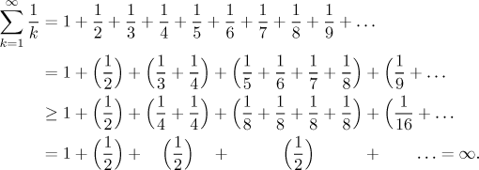
Lab 1 – Basel Problem
The harmonic series diverges

Slide 34
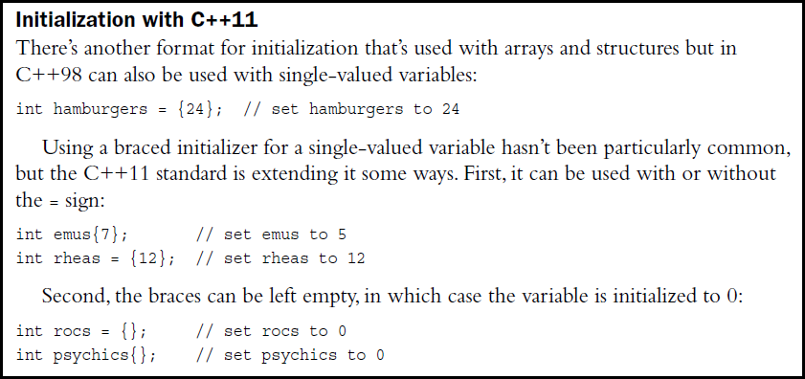
C++11 Initialization
http://www.cplusplus.com/reference/cfloat

Slide 35
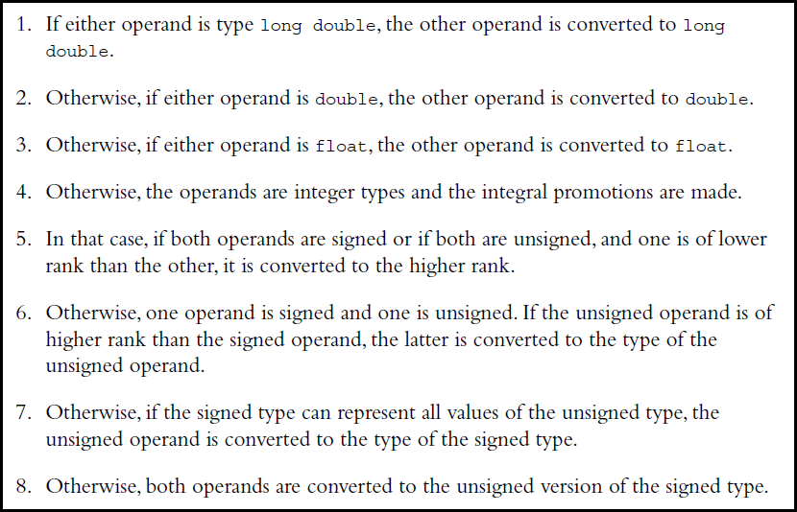
Implicit Operand Conversions

Slide 36
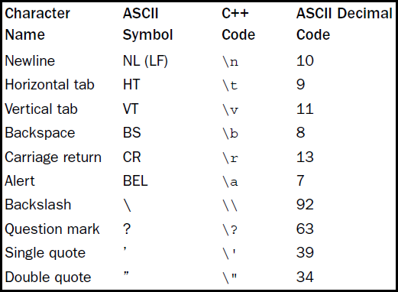
C++ Escape Sequence Codes

Slide 37
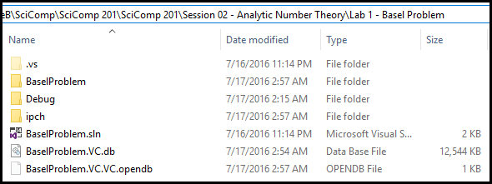
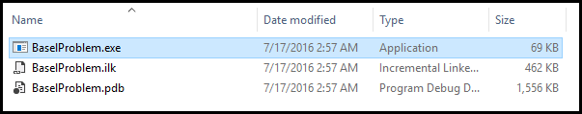
Solution File System
Precompiled Headers
Visual Studio Solution (.SLN) file

Slide 38
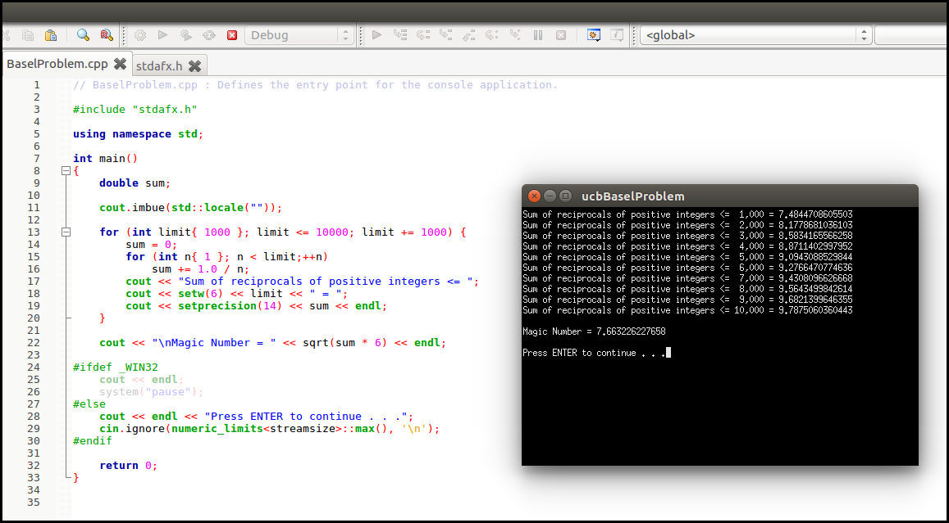
Lab 1 – Basel Problem
Ubuntu 16.04 and Code::Blocks 16.01

Slide 39
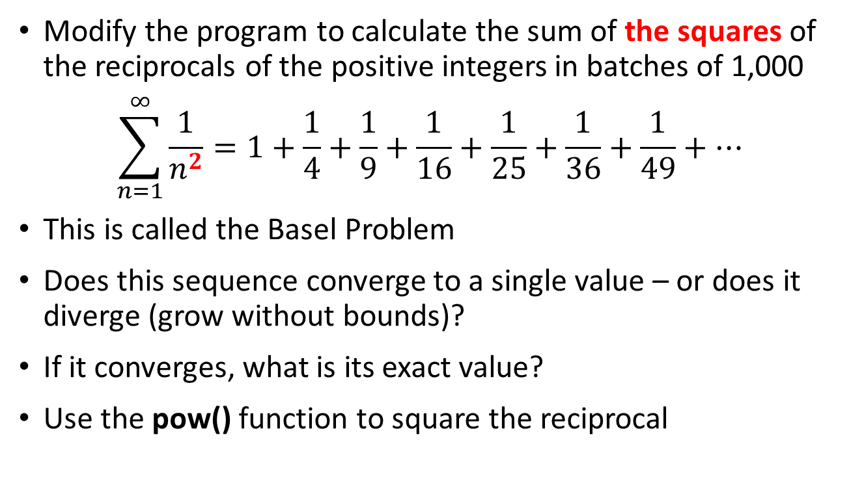
Lab 1 – Basel Problem
Modify the program to calculate the sum of the squares of the reciprocals of the positive integers in batches of 1,000
$$\sum_{n=1}^{∞}{\frac{1}{n^{2}}=1+\frac{1}{4}+\frac{1}{9}+\frac{1}{16}+\frac{1}{25}+\frac{1}{36}+\frac{1}{49}+…}$$
This is called the Basel Problem
Does this sequence converge to a single value – or does it diverge (grow without bounds)?
If it converges, what is its exact value?
Use the pow() function to square the reciprocal

Slide 40
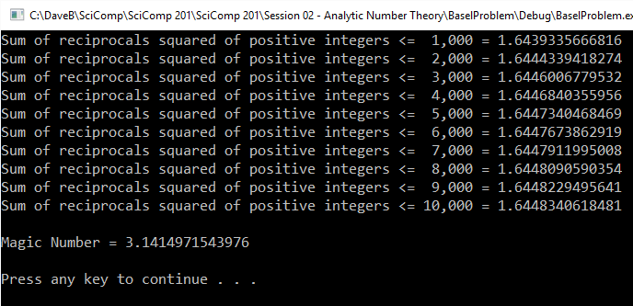
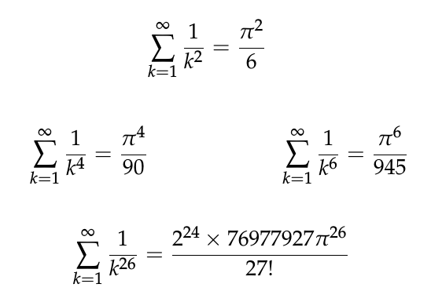
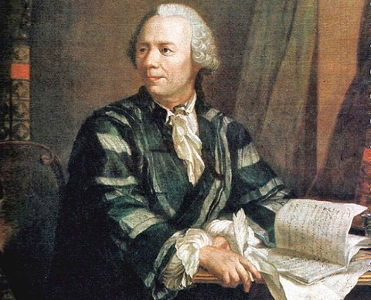
Lab 1 – Basel Problem
The series converges

Slide 41
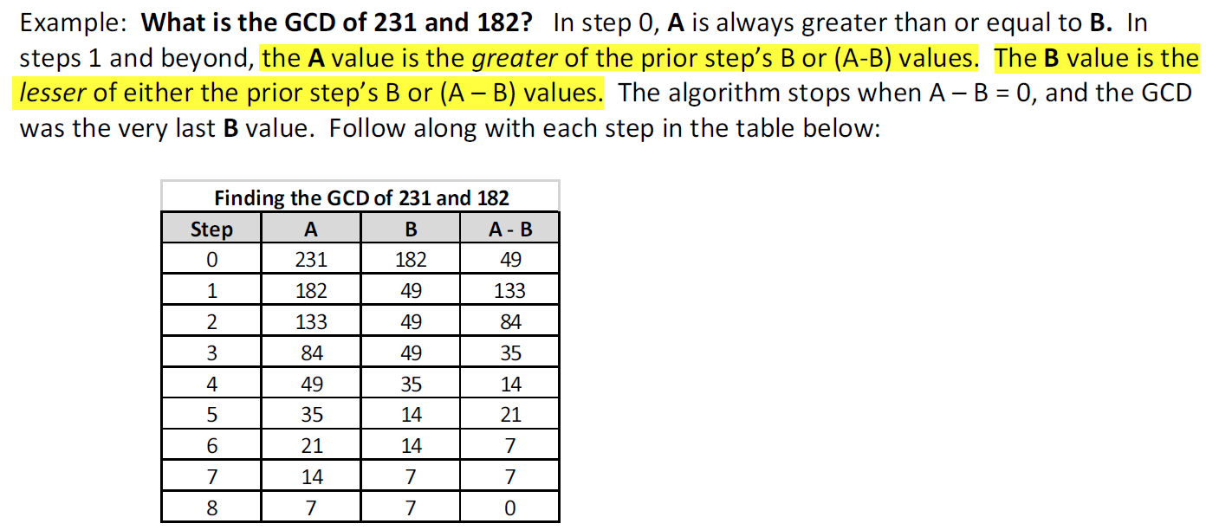
Greatest Common Divisor (GCD)
What divides A and B must also divide the difference of A - B
Why?
Given {A, B, a, b, r} ∊ ℤ
$$A=a ∗r, B=b ∗r$$
$$\left(A −B\right)=a∗r −b ∗r$$
$$a −b= \frac{\left(A −B\right)}{r}$$
∴ One can determine the GCD without having to factor either of the two integers!

Slide 42
Lab 2 – Coprime Probability
Create the lab 2 solution to calculate the average number of times a million pairs of random integers (1 ≤ n ≤ 100,000) are coprime (GCD == 1)
You must implement the Greatest Common Divisor algorithm using whatever mathematical optimizations you prefer to speed up the performance
Copy contents of stdafx.h from Lab 1 to Lab 2
Add #include <random> at bottom of this stdafx.h
What does this experiment estimate to be the probability that two randomly chosen integers are coprime?

Slide 43
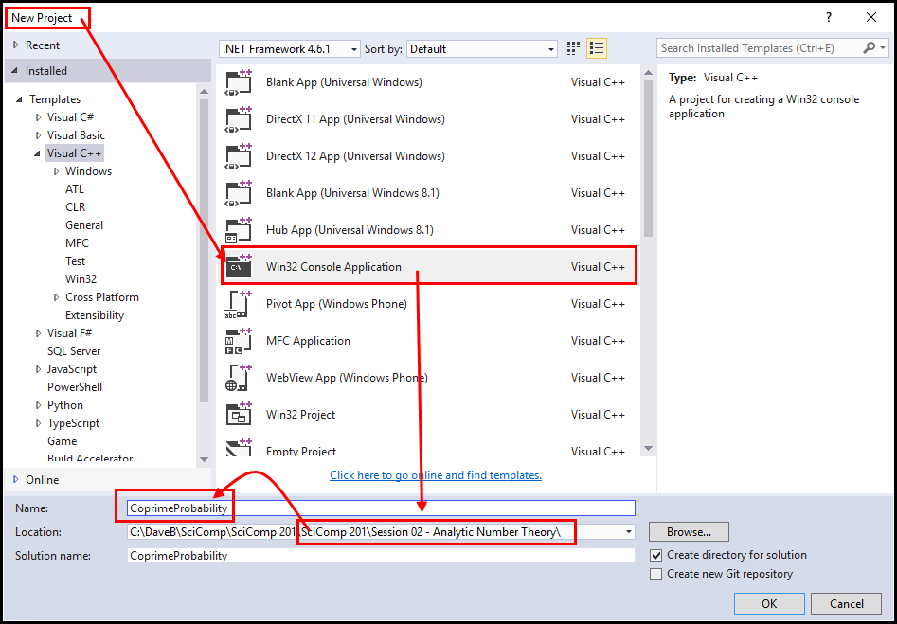
Create “CoprimeProbability” Solution

Slide 44
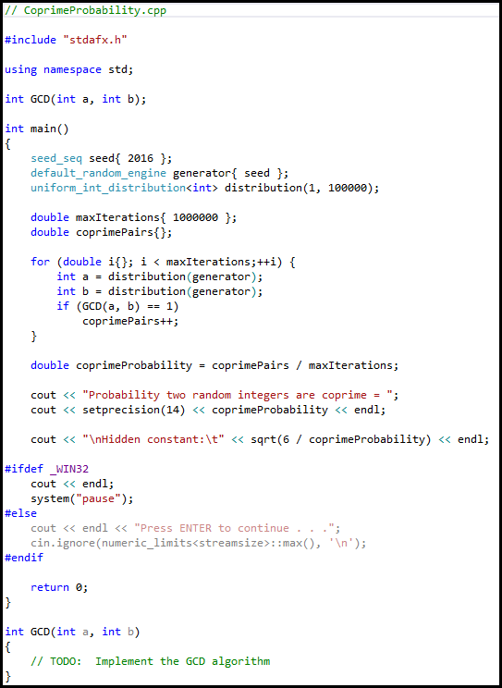
main()
Function Prototypes
see_seq { 2016 }
vectors
default_random_engine
generator { seed }
PRNG
uniform distribution
distribution(generator)
return in GCD()

Slide 45
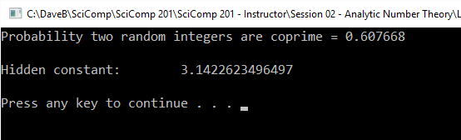
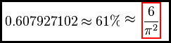
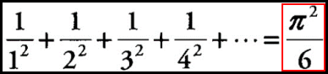
Lab 2 – Coprime Probability

Slide 46
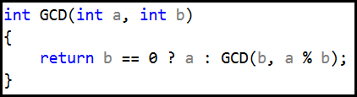
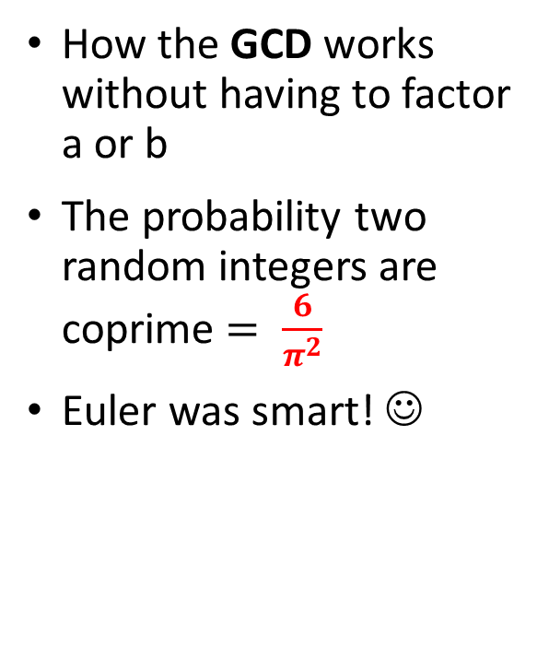

Now you know…
How to generate a pseudo-infinite series (harmonic and Basel)
How to map elements to code constructs
The difference between convergent and divergent series
The closed-form (analytic) solution to the Basel series = $\frac{π^{2}}{6}$
How the GCD works without having to factor a or b
The probability two random integers are coprime $= \frac{6}{π^{2}}$
Euler was smart! ☺

